Slide 1

The Photoelectric Effect

Slide 2
Experiment
Objective of the experiment
Theory
Working formula
Experimental Data
Graphical Analysis
Calculation
Results
Precautions & Discussion

Slide 3
Objective of the experiment
I. To determine Planck’s constant ‘h’
II. To determine the work function “φ” of metals.

Slide 4
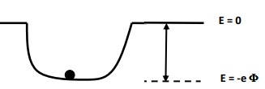
Theory
An electron in a metal can be modelled as a particle in an average potential well due to the net attraction and repulsion of protons and electrons. The minimum depth that an electron is located in the potential well is called the work function of the metal, Φ. It is a measure of the amount of work that must be done on the electrons (located in the well) to make it free from the metal. Since different metal atoms have different number of protons and different values for electrical properties, the work function (Φ) depends on the metal.

Slide 5

Theory
When a photon with frequency “ν” strikes the surface of a metal, it imparts all of its energy to a conduction electron near the surface of the metal. If the energy of the photon (hν) is greater than the work function (Φ), the electron may be ejected from the metal. By conservation of energy, the maximum kinetic energy with which the electron could be emitted from the metal surface T_{max}, is related to the energy of the absorbed photon hν, and the work function Φ, by the relation,

Slide 6
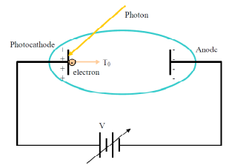
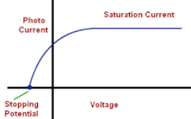


Theory
Now, if we consider the case of electrons being emitted by a photocathode in a vacuum tube, all emitted electrons are slowed down as they approach the anode. If the voltage just stops the electrons (with maximum kinetic energy T_{max}) from reaching the anode. The voltage required to do this is called the “stopping potential" (V₀).
Working formula

Slide 7
We will focus on this part of the Photo current vs. Voltage curve
Working formula

Slide 8
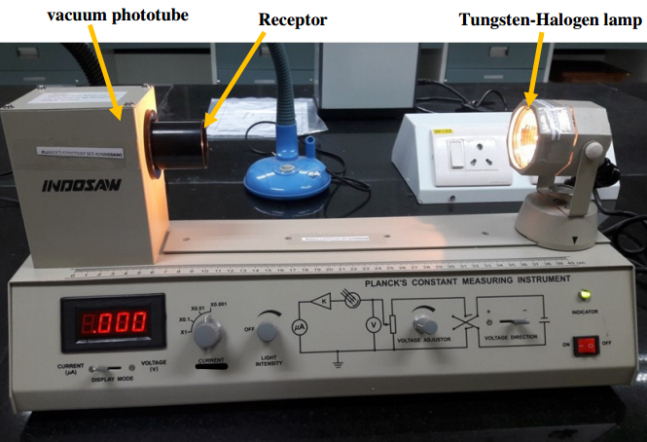
Experimental Set-up*

Slide 9
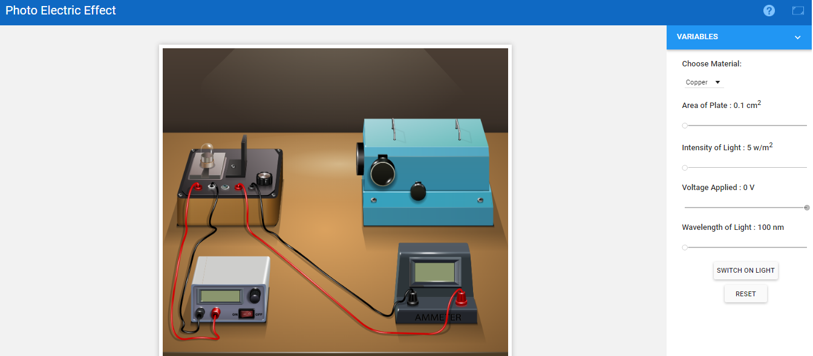
Experimental Set-up (Virtual)
Link: http://mpv-au.vlabs.ac.in/modern-physics/Photo_Electric_Effect/experiment.html
The control panel

Slide 10
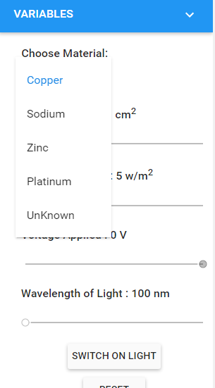
Experimental Set-up (Virtual)

Slide 11
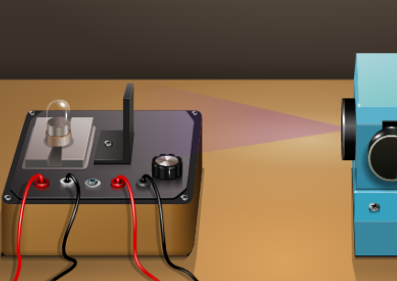
Experimental Set-up (Virtual)

Slide 12
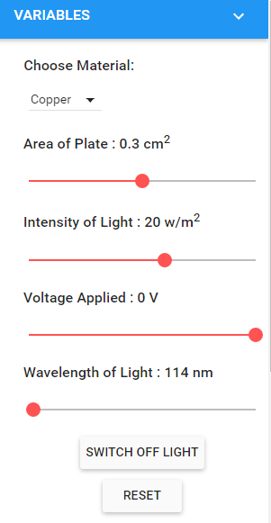
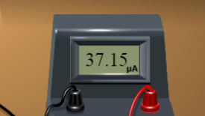
Experimental Set-up (Virtual)
Set all the three knobs.
Fix area and intensity at a reasonable value. You should not change these while taking data.
Voltage should be maximum (i.e., 0).
Record data for current.

Slide 13
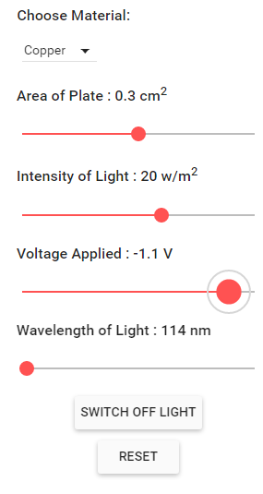
Experimental Set-up (Virtual)
Vary the voltage and record the current till the value of current becomes zero.
Record data for current for each voltage.

Slide 14
Experimental Set-up (Virtual)
Vary the voltage and record the current till the value of current becomes zero.
Record data for current for each voltage.
This provides you with data to plot the I-V characteristics for the wavelength (or frequency).
Repeat for at least 3-4 frequencies.

Slide 15

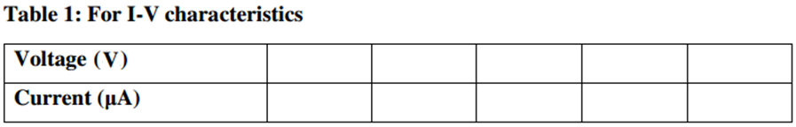
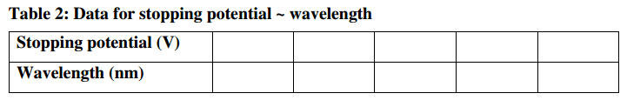
Experimental Data
Chosen colors and corresponding wavelengths:
(To be prepared for all frequencies)

Slide 16
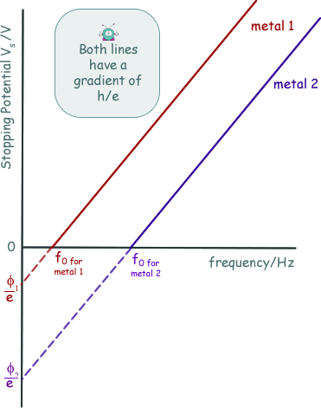
Graphical Analysis
Graph:
Experiment has to be repeated for at least TWO different metals.
Plot I~ V characteristics for different wavelengths.
Plot Stopping potential ~ frequency (i.e., c/wavelength). A sample graph is shown.

Slide 17

Calculation, Result, Precautions
Graph:
Calculate the slope and intercept using the working formula.
Determine h. Take an average.
Determine φ for different metals.
?
?

Slide 18
Extra Slides for discussion on
Photoelectric Effect Phenomena
(Could be added at the beginning as per need of the instructor)

Slide 19
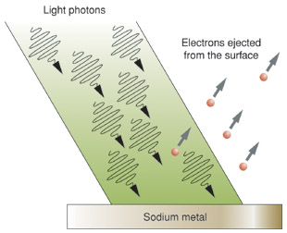
Photo (light) + electric
A photoelectric effect is any effect in which light energy is converted to electricity.
First explained by Albert Einstein in 1905

Slide 20
Photoelectric Effect
Metal Foil

Slide 21
Photoelectric Effect
As blue light strikes the metal foil, the foil emits electrons.
Metal Foil

Slide 22
Photoelectric Effect

Slide 23
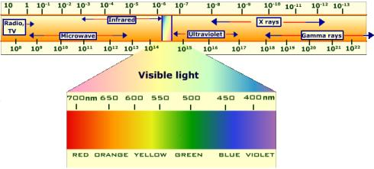
Photoelectric Effect
When red light hits the metal foil, the foil does not emit (give off) electrons.
Blue light has more energy than red light.
How could we get more energy into the red light?
Try increasing the brightness (intensity).

Slide 24
Photoelectric Effect

Slide 25
Photoelectric Effect
That didn’t work
Maybe its still not bright (intense) enough.

Slide 26
Photoelectric Effect
Still not working.
What happens with brighter (more intense) blue light?

Slide 27
Photoelectric Effect
More electrons emitted.

Slide 28
Photoelectric Effect
Much more blue light means much more electrons emitted, but that doesn’t work with red!

Slide 29
Photoelectric Effect
High FREQUENCY light even from a dim source can eject electrons from a photosensitive metal
Low FREQUENCY light, even very bright (very intense) cannot dislodge electrons

Slide 30
Photoelectric Effect
Light, like all other radiation, is made up of small particles called photons.
The higher the frequency, the more energy the photons have.
Einstein stated that light interacts with matter as a stream of particle-like photons.
Einstein received the Nobel Prize for this discovery.

Slide 31
Photoelectric Effect
If a photon hits an atom of a certain material, it may be absorbed by an electron of that material.
However, if the photon has enough energy, the electron is ejected, or emitted, from the atom.
In this way, light energy changes into electrical energy.

Slide 32
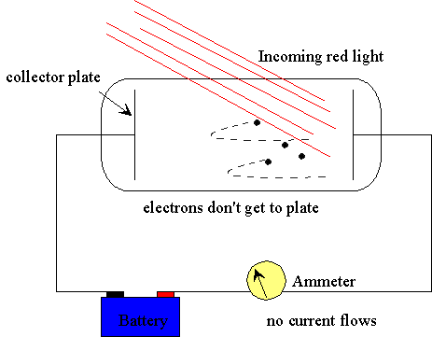
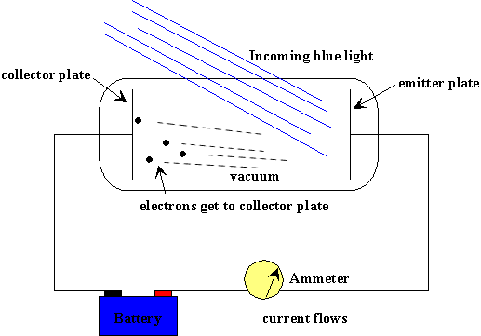
Photoelectric Effect
If wires are attached to a photoemittive material, the electrons can flow along the wires, forming an electric current.

